Slide 1

The Last Jedi Reviews
Sentiment & Topics
Torin Rettig

Slide 2
Project
Sentiment analysis and topic modeling on reviews of Star Wars: The Last Jedi to gain insight on viewer response

Slide 3
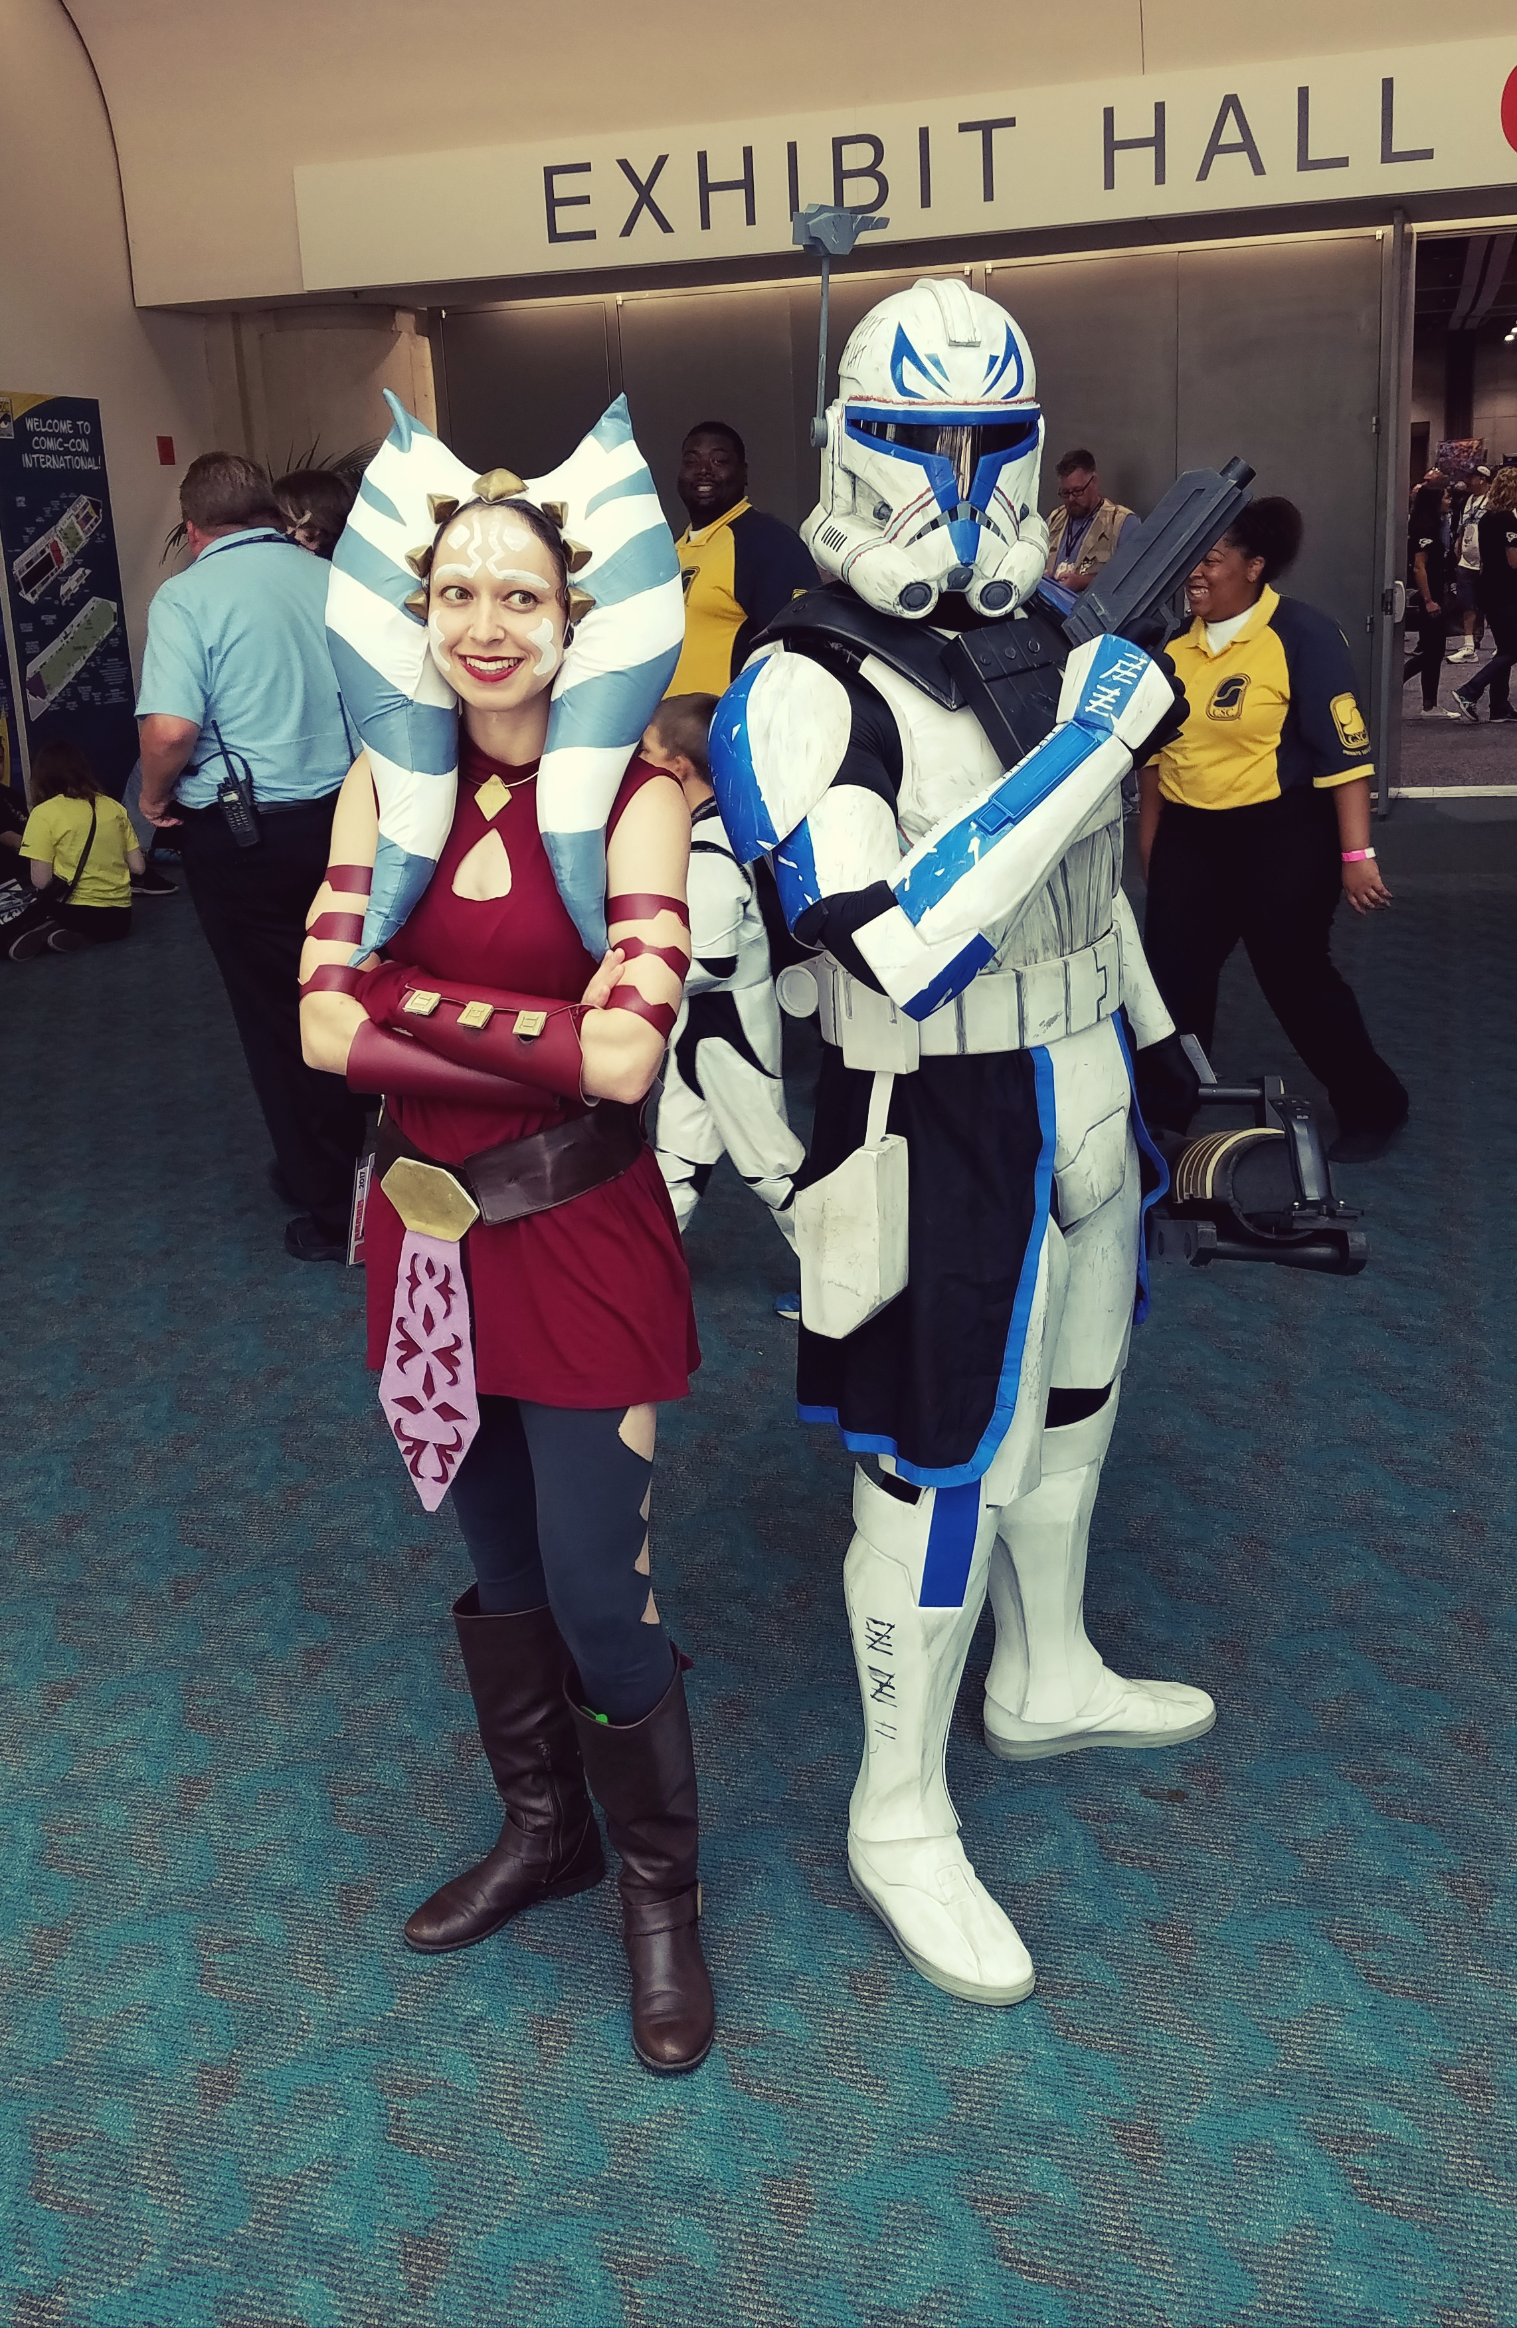
Motivation
Content creators need insights on customer response to their products
Engaged fanbases both reflect this response and drive the conversation
Consumer insights can guide engagement and effective product development
Notes:
Content creators need insights on consumer response to their products
Engaged fanbases who write impassioned reviews both reflect this response and drive the conversation on content
These insights can be used to inform public relations and social media efforts and guide future content creation

Slide 4
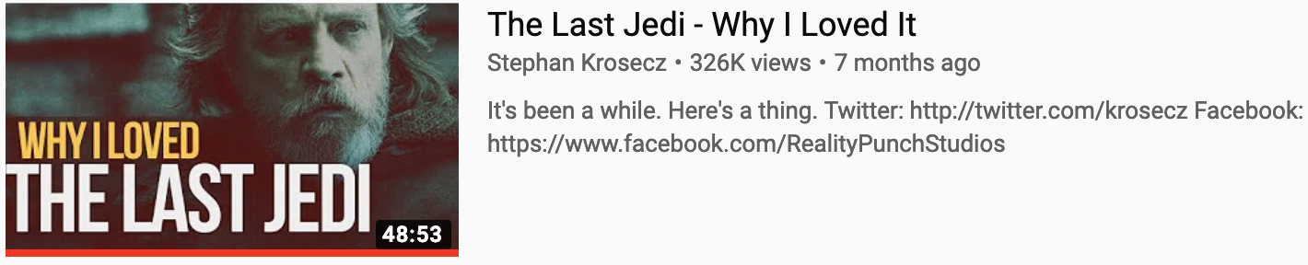
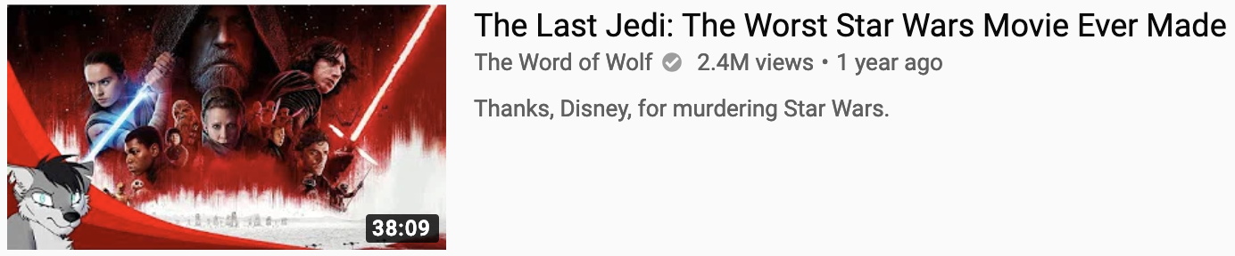
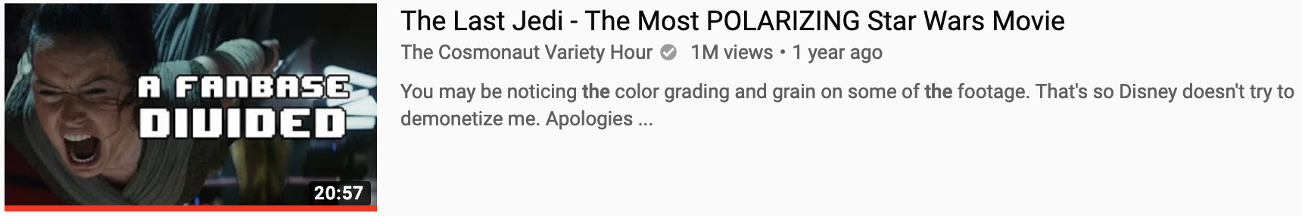
Why The Last Jedi?
TLJ has had the most polarized response of any Star Wars film
Raised concerns about toxicity
Angry fanbases are a big concern, esp. for film and game makers
A method to identify specific topics of fan concern is very valuable
Notes:
TLJ has had the most polarized response of any SW film ever
It is said to have split the fanbase in two and raised serious concerns about toxicity of the fanbase
Toxic fanbases can be very damaging for any product
Coming up with an effective method to easily discern the overall concerns of the fanbase would be invaluable to content creators

Slide 5
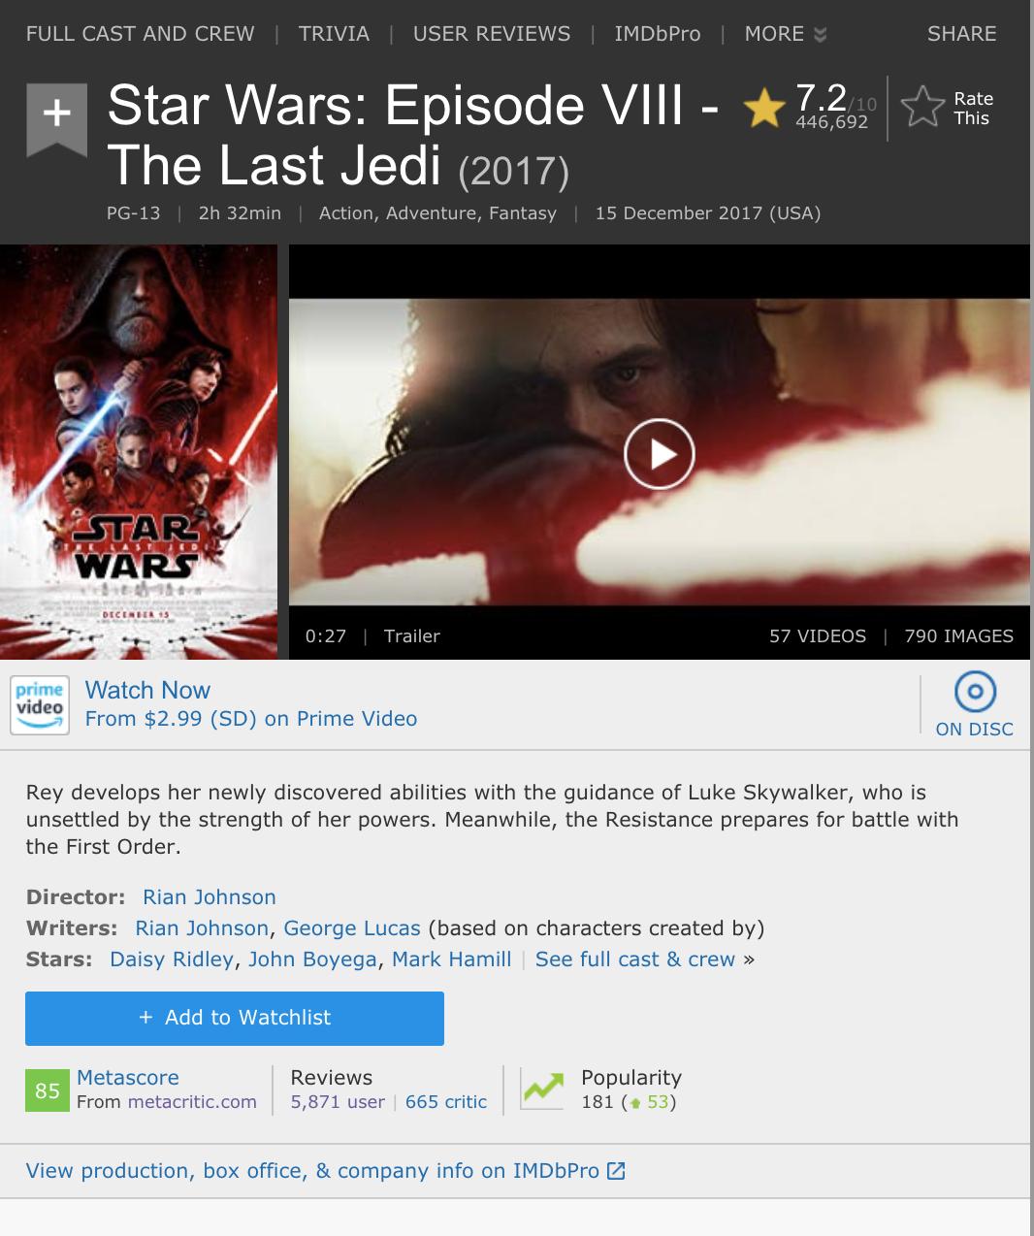
Data
5865 user reviews and review scores for Star Wars: The Last Jedi webscraped from IMDb
Notes:
The data used for this project was 5865 written user reviews and review scores on IMDb
I used standard web scraping to get the reviews and scores

Slide 6
Methodology
Use unsupervised learning to identify the sentiment valence of the reviews (positive, neutral, negative)
Use unsupervised learning to identify primary topics of the negative reviews to better understand user concerns
Notes:
For the modeling I used unsupervised learning techniques to assign a sentiment valence to each review of positive, neutral or negative
Then I used unsupervised clustering identify the main topics of the negative valence reviews since those are the ones we’re most concerned with

Slide 7
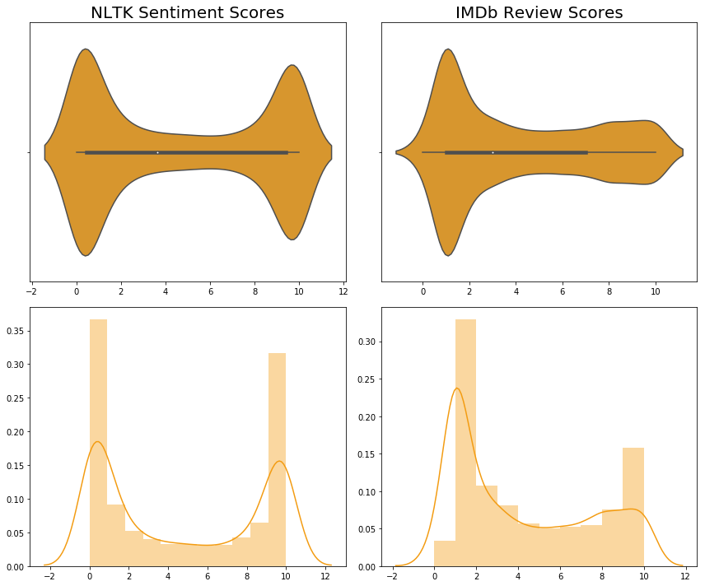
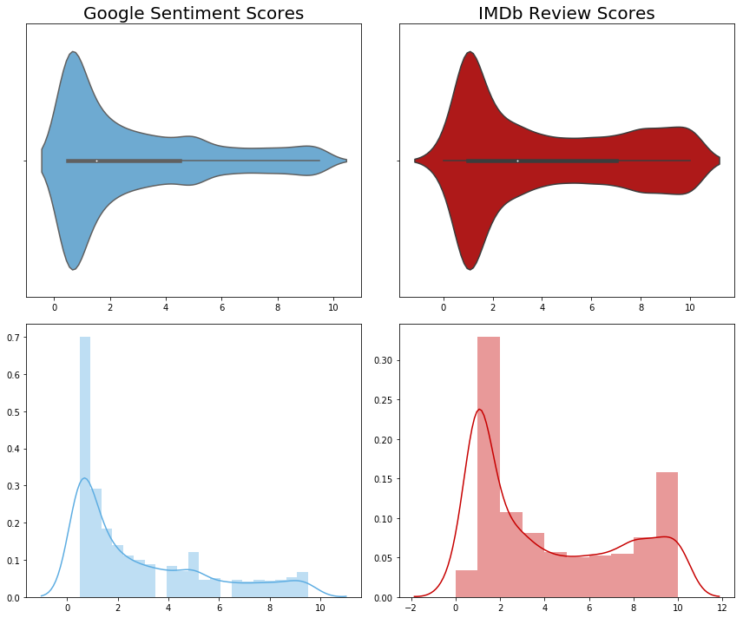
Sentiment Analysis
Negative
Positive
Negative
Positive
Negative
Positive
Notes:
I used a few approaches for sentiment analysis:
NLTK’s built-in sentiment analysis tool
Sentiment Analysis tool from Google Cloud’s Natural Language API
The main thing to pay attention to here are the shapes of the distributions. We’re looking for the approach that is closes to the target IMDb sentiments.
And as you can see the Google distribution is much closer than NLTK
The x axis on all of these graphs is the scale from 1-10 in terms of sentiment with 10 being the most positive
The colors represent each comparison of the IMDb scores to the sentiment

Slide 8
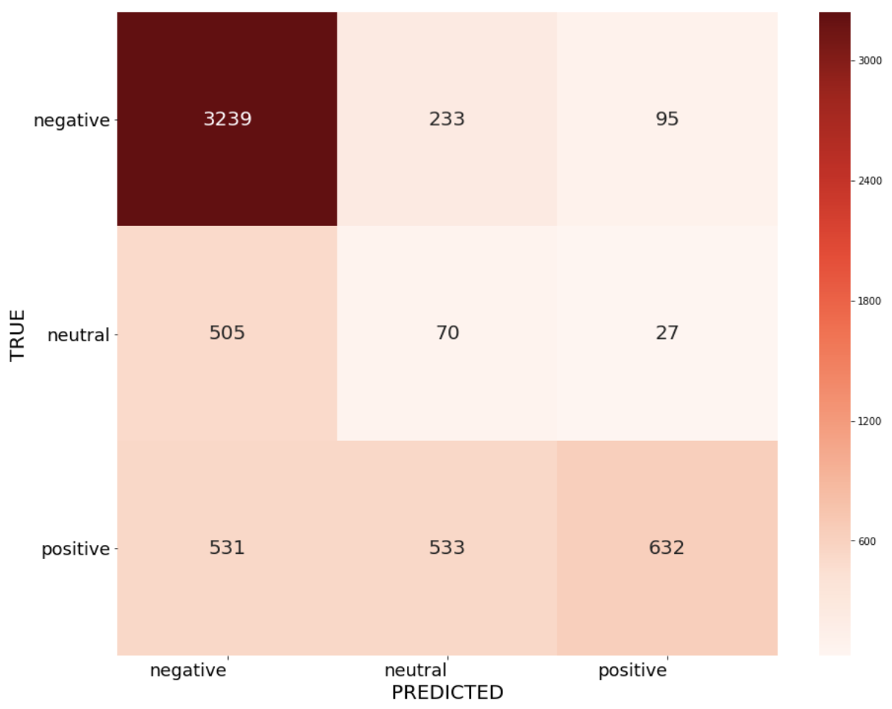
Sentiment Analysis
Google Sentiment Performance
Sentiment | Recall
Positive | 0.3726
Neutral | 0.1163
Negative | 0.9080
Overall | 0.6719

Slide 9
Topic Modeling: NMF & Bigrams
NMF – 20 Topics – Bigrams
terrible
plot holes
holes
Bad
Storytelling
Topics
Bad Storytelling
Corporate Moviemaking
Franchise Stewardship
Doesn’t Feel Like Star Wars
Bad Jokes
Plot Holes
Self-Parody
character development
story
corporate
assembly line
Corporate
Filmmaking
rip off
crass
hollywood
stinky fish
Notes:
For topic modeling on the negative reviews NMF produced the best results
Setting the topic number to 20 and using bigrams produced the most discernable topics
We ended up getting about 7 out of 20 topics that were useful
While that’s not ideal, it’s much better than the other techniques I used

Slide 10
Conclusions
Google Cloud Natural Language API is a solid sentiment analysis option
NMF proved to be the best for this topic modeling task
Additional tweaking of NMF would probably continue to yield improved results

Slide 11

Future Work
Gather additional reviews from RT, Metacritic and Amazon to improve topic clarity
Model additional movies to create a more generalizable model
Create an app that serves up reviews relating to topics and key words for deeper examination

Slide 12
Thank you!

